Slide 1
Chapter-1
The Business Intelligence Environment

Slide 2
Aspects of a Business Intelligence and Analytics Platform and Strategy

Slide 3
Introduction
The whole process of business intelligence can be divided into four stages:
Data gathering
Data cleaning/standardization
Analysis
Reporting

Slide 4
1. Fundamentals and Requirements
The requirements solicitation and analysis process itself creates a need for tools supporting the exploratory and documentary aspects of BI and analytics.
These types of tools must help the analysts in understanding the business performance objectives and key value drivers for the organization

Slide 5
2. Business Intelligence Architecture and Design
The BI architecture will incorporate designs for the platforms to enable analysis, as well as application design, testing, and the necessary project management.

Slide 6
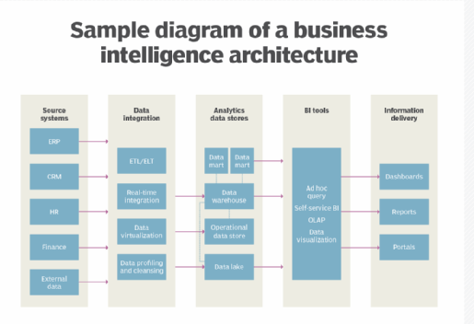

Slide 7
3. Data Preparation
Having identified the sources of data and developed the target data models within the data warehouse, the next component addresses the streaming of information from the originating sources into the analytical platform.
This incorporates all aspects of preparing data for integration into a platform for reporting and analysis, including data extraction, data quality, data transformation, as well as other integration and preparation techniques such as data virtualization, change data capture, and data warehouse loading.

Slide 8
4. Data Integration
The original terms used for data integration were Extraction, Transformation, and Loading, or ETL.
But these days data integration encompasses much more than these aspects of moving data from the sources to the targets.
It involves all aspects of data sharing, which can lever the traditional ETL

Slide 9
5. Business Intelligence Platforms
A business intelligence (BI) platform is technology that helps businesses gather, understand, and visualize their data. It serves as the backbone of a company's business intelligence strategy, which is how a company uses information to make better decisions.

Slide 10
6. Analysis
The ‘‘intelligence’’ in business intelligence comes from a combination of ways of aggregating, summarizing, organizing, and analyzing data, with the results presented to the knowledge consumers.

Slide 11
7. Delivery and Presentation
Framework provides the means for developing and delivering reports, responding to ad hoc queries, as well as interactive delivery and presentation of dashboards and delivery to a diverse set of web-based, mobile, and handheld platforms.

Slide 12
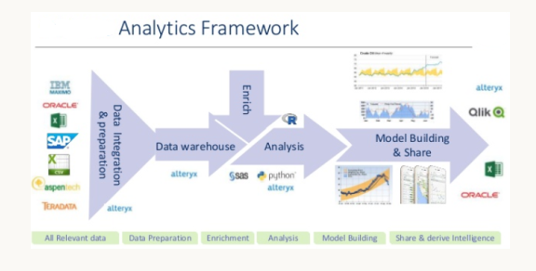
Case Study

Slide 13
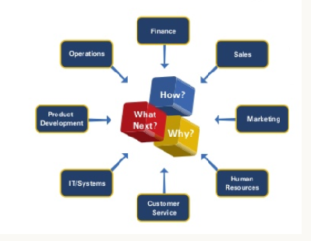

Slide 14
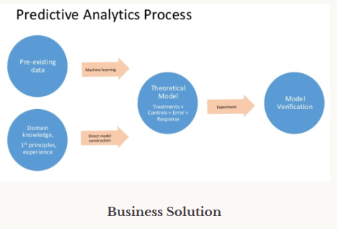

Slide 15
The Organizational Business Intelligence Framework

Slide 16
Introduction
This incorporates the procedural approaches to soliciting requirements, developing models, and developing business analytics applications with the supplemental tools, employed by skills engineers applying techniques to use those tools.

Slide 17
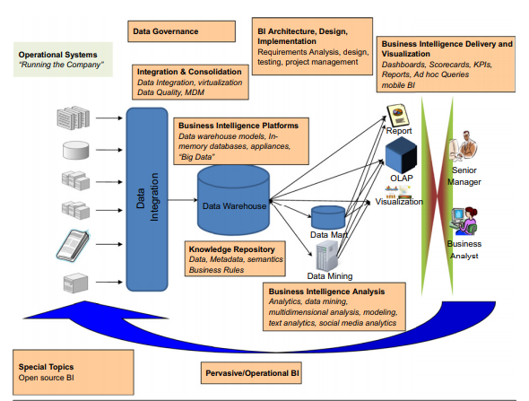
End-to-End Strategy

Slide 18
Business Process Modeling and Analytic Needs Assessment
Business process modeling engages both the business people and the technologists to review the task flows of both operational and analytical business activities.
Business process modeling and information flow modeling together expose what information a business needs and how that information moves from its sources to its destination.

Slide 19
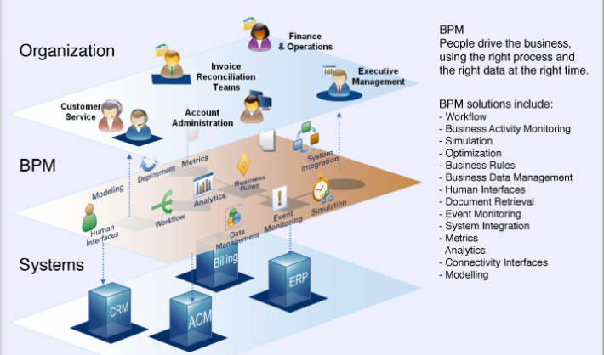

Slide 20
Metadata Management
The organic development of application systems over time has created an environment of disparate representations of source data, which complicates the process of merging and consolidation when data sets are brought into the data warehouse.

Slide 21
Data Modeling
Variations in original source table and file structures also complicate the data consolidation process.
Data modeling tools are used in capturing existing source data models, molding suitable representations of domains and activities to be analyzed, as well as facilitating reports and responding to analyses and queries.

Slide 22
Data Profiling
Data profiling refers to a number of processes used to discover metadata, evaluate the statistical characteristics of data sets, validate data against defined business rules, and document relationships between columns within a data set.
Data profiling tools are used as part of the data discovery and assessment processes

Slide 23
Data quality
Data quality tools are used to validate data during the data extraction and transformation phases based on rules related to client data expectations.

Slide 24
Business Rules
any operational or analytical process that is involved in running or improving a business is driven by a set of business rules.
Whether these rules are dictated by external bodies (such as a regulatory board), by internal directives (such as an executive process leadership group), or by the way that business is done within an industry, there is a method to separate the rules that drive a process from the process itself.

Slide 25
Database Management System
the BI environment relies on the use of a database management system (DBMS) for information management.

Slide 26
Text Analysis
Data organized within a formal representation that conforms to defined types and structures is called structured data;
information that is incorporated into a document (or framework) that has some basic structure and taxonomy are said to be semi-structured, in that they exhibit some structure that is looser than the standard pairing of data within a database table.
Free-form text is said to be unstructured data.

Slide 27
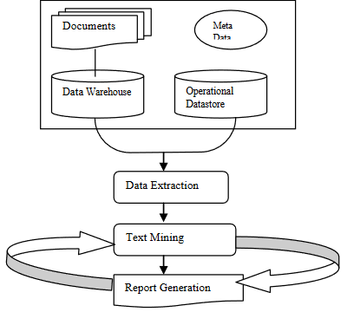

Slide 28
Predictive analytics
Predictive analytics use statistical analysis as well as data mining techniques such as clustering, classification and segmentation, and pattern detection.
Predictive analytics processes are rapidly becoming a necessary business analytics component.

Slide 29
Dashboards and Other Visualization
Techniques
Information packaging and delivery provides for assembling reports and documents in the best format for the business client and the means for delivering all the information packages to their destinations in a timely manner.
Senior executives often refer to dashboards and scorecards to provide a high level review of key performance indicator scores.

Slide 30
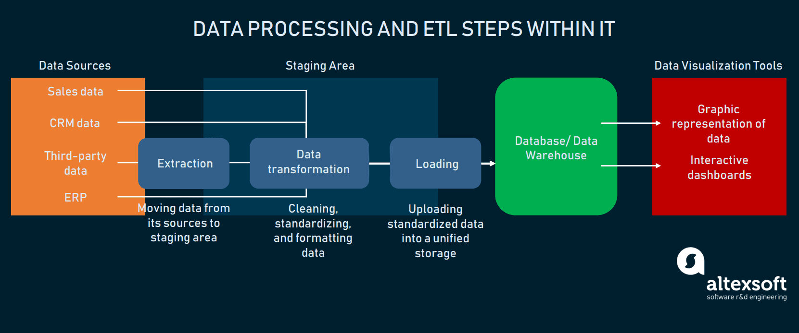

Slide 31
System/Network Management
hardware and software architecture, the more mundane aspects of network and system management are not to be ignored.

Slide 32
Data Security
A security framework incorporates: n Hardware and software firewalls for managing network traffic;
Encryption of data at any point that data is ‘‘in the clear,’’ or moving between systems such as data integration, consolidation, or as reports or notifications;
Intrusion protection, to prevent outsiders from breaking into the system; these applications may include rule-based and behavior-based monitoring to look for suspicious network behavior;
Policies for managing or restricting client access to specific data sets within the RDBMS, whether on the table, column, or row level; and
Policies for controlling access to data and security for analytical and interface tools.

Slide 33
Services and System Evolution

Slide 34
Business Processes and Information Flow

Slide 35
Introduction
Business applications exist for running the business, while business intelligence (BI) applications report performance measures reflecting how well the business is run.
There should be a logical sequence to application development that begins with an assessment of the scope of a particular desired outcome, usually related to an existing (or developing) process employed in operating the business.

Slide 36
Analytical Information Needs and Information Flows
A good way to motivate the discussion of business process mapping and information flows is looking at a specific example, such as analyzing customer activities for the purposes of creating customer profiles.
First, you must determine what information will be required to do this analysis, and then determine where the data sets will be sourced, as well as how the information is to be extracted, transformed in preparation for integration into the analytical platform, and how that information is to be organized for analysis.
Next, you must be able to consider rapid methods for integrating new data sets when it is determined that they are to be included in the analytical environment.

Slide 37
1. The Value of Modeling Information Flow
Even when considering the creation of an analytical environment, there is value in understanding the ins and outs of the transactional and operational business processes and their corresponding application and information flows.
The results of a BI activity are not limited to a company’s interaction with customers; those analyses can generate actionable knowledge as a result of manipulating data sets accumulated from a large collection of data producers, such as internal (i.e., within the organization) and external (i.e., cross-company) business applications.
As an example, consider a supply-chain interaction between your company and a collection of product suppliers.

Slide 38
2. Process Design Versus Application Implementation
To remedy the eventual effects of this development process, an important part of the methodology of designing and implementing a business application is modeling the business process as a way of guiding the algorithmic implementation.

Slide 39
3. Benefits of the Business Process Model
There are some major benefits for building this model, such as:
  Understanding an information flow provides logical documentation for the business process;
  The review may uncover additional opportunities for adding value through different kinds of analytical processing;
  Business modeling process helps in understanding business consumer data use;
  and Business modeling helps in communicating user requirements to the implementation team.

Slide 40
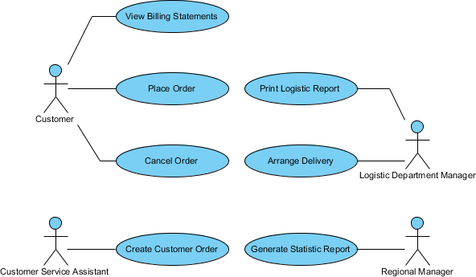

Slide 41
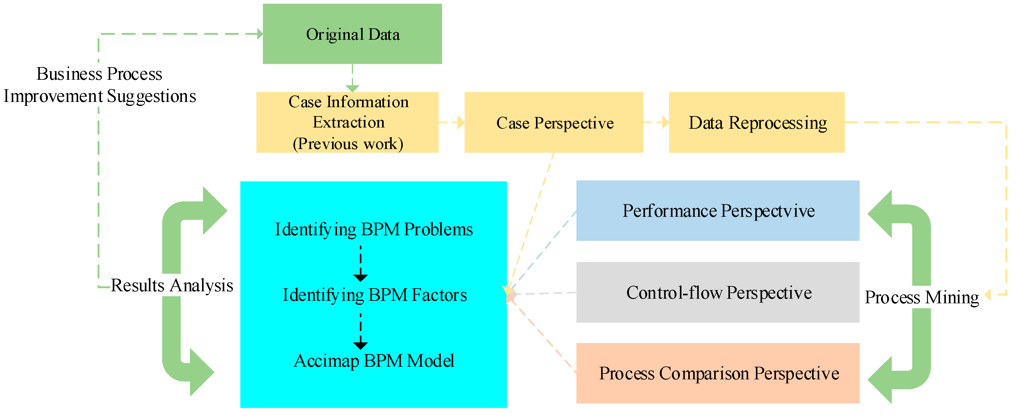

Slide 42
Information Processing and Information Flow

Slide 43
Introduction
Transaction Processing
Operational Processing
Batch Processing
Analytical Processing

Slide 44
Transaction Processing
Operations in a transaction processing system are interactions between a user and a computer system where there is the perception of an immediate response from the system to the user’s requests.
A commonly encountered example of transaction processing is the use of an automated teller machine (ATM)

Slide 45
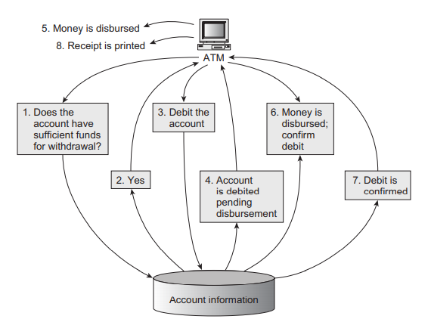
ATM example

Slide 46
Operational Processing
A business or operational process is an organized set of activities or tasks that produces a specific service or product.

Slide 47
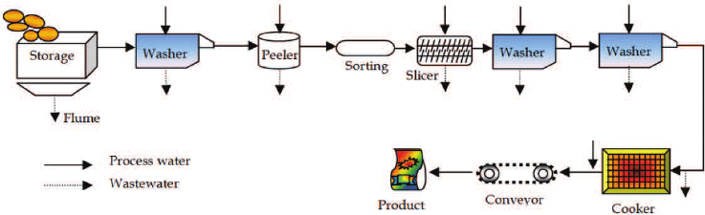
Example

Slide 48
Batch Processing
In contrast with transaction processing, batch processing takes collections of sequences of similar operations that are to be executed in batches (hence the name).
Although both transaction processing and batch processing execute a series of operations, batch processing differs from transaction processing in terms of information flow in the granularity of application of each processing stage.

Slide 49
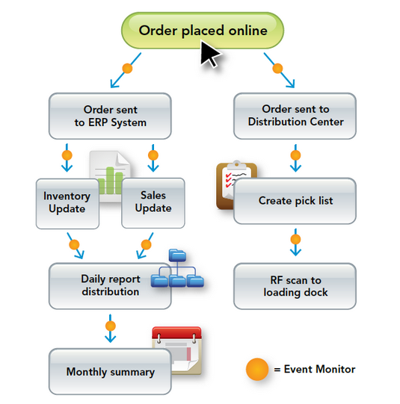
Example

Slide 50
Analytical Processing
Analytical processing involves the interaction between analysts and collections of aggregated data that may have been reformulated into alternate representational forms as a means for improved analytical performance.

Slide 51
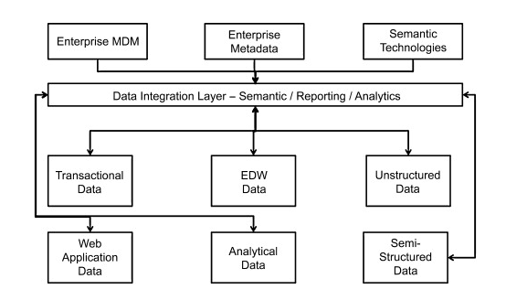
analytics processing in the next-generation data warehouse platform.

Slide 52
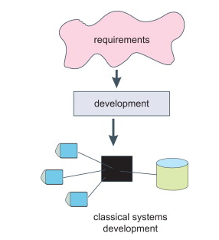

Slide 53
The Information Flow Model

Slide 54
Introduction
This will expose how both information and control are shared and propagated through the business application.
It is useful to have a method for describing the way data propagates through a system,

Slide 55
Information Flow: Processing Stages

Slide 56
Information Flow: Directed Channels

Slide 57
Data Payload Characteristics

Slide 58
Data Requirements Analysis

Slide 59
Introduction

Slide 60
When the key stakeholders in the organization have agreed to pursue a business intelligence (BI), reporting, and analytics strategy, it is difficult to resist the urge to immediately begin evaluating tools for the purposes of acquisition and deployment.
The process of acquiring BI tools acquisition is well-defined, with clearly-defined goals, tasks, and measurable outcomes.

Slide 61
Business Uses of Information
there is a wide variety and number of consumers of BI and analytics across the organization.
Some of these consumers are more casual than others when it comes to reporting and analytics, but one common theme among the different types is the use of the information to inform and influence decision-making.

Slide 62
